Slide 1
Sociology in Modules
The Family and Intimate Relationships

Slide 2
The Family and
Intimate Relationships
13
Module 39: Global View of the Family
Module 40: Marriage and Family
Module 41: Alternatives to Traditional Families

Slide 3
A Look Ahead
What are families in different
parts of the world like?
How do people select mates?
When a marriage fails, how does
the divorce affect the children?
What are the alternatives to the nuclear family and how prevalent are they?

Slide 4
Composition:
What is the Family?
Module 39
Family: Set of people related by
blood, marriage, or agreed-upon
relations who share primary
responsibility for reproduction
and caring for members of society
  Nuclear family: Nucleus or core
  upon which larger family groups are built
  Extended family: Family in which relatives live in same home as parents and children

Slide 5
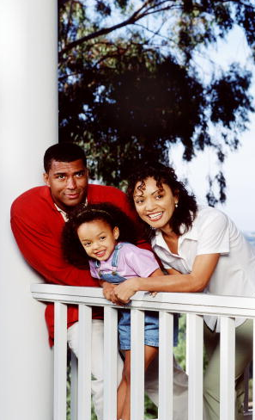
Composition:
What is the Family?
Module 39
Monogamy: Form of marriage in which one woman and one man are married only to each other
Serial monogamy:
When a person has
several spouses in his
or her lifetime, but
only one spouse at a time

Slide 6
Composition:
What is the Family?
Module 39
Polygamy: When an individual has several husbands or wives simultaneously
Polygyny: Marriage of a man to
more than one woman at a time

Slide 7
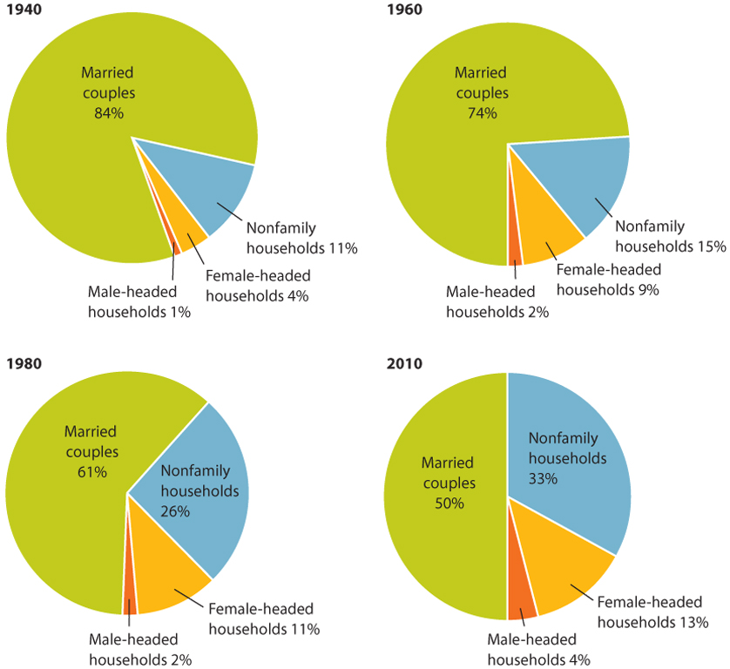
Figure 39-1: U.S. Households by Family Type, 1940-2010
Module 39

Slide 8
Kinship Patterns: To
Whom are We Related?
Module 39
Kinship: State of being related to others
  Bilateral descent: Both sides of a person’s family are regarded as equally important
  Patrilineal descent: Only the father’s relatives are important
  Matrilineal descent: Only the mother’s relatives are important

Slide 9
Authority Patterns:
Who Rules?
Module 39
Patriarchy: Males are expected to dominate in all family decision making
Matriarchy: Women have
greater authority than men
Egalitarian family: Family in
which spouses are regarded as equals

Slide 10
Functionalist View
Module 39
Family serves five functions for society:
  Reproduction
  Protection
  Socialization
  Affection and companionship
  Provision of social status

Slide 11
Conflict View
Module 39
Family reflects inequality in wealth
and power found within society
In wide range of societies,
husbands exercised power
and authority within the family
View family as economic unit that contributes to social injustice

Slide 12

Interactionist View
Module 39
Focuses on microlevel
of family and other
intimate relationships
Interested in how
individuals interact with
each other, whether
they are cohabiting
partners or longtime
married couples

Slide 13
Feminist View
Module 39
Interest in family as social institution
Urge social scientists and agencies
to rethink notion that families in
which no adult male is present are automatically cause for concern
Feminists stress need to investigate neglected topics in family studies

Slide 14
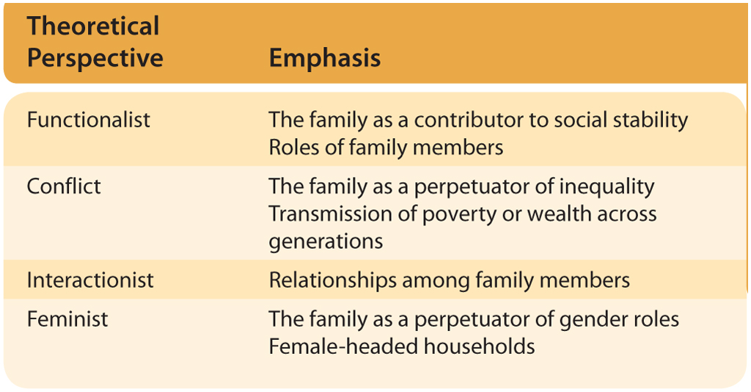
Table 39-1: Sociological Perspectives on the Family
Module 39

Slide 15
Marriage and Family
Module 39
Over 95% of all men and women in U.S. marry at least once during their lifetimes
  Internet is second to friends
  as a source of romantic partners
  Process of mate selection is
  taking longer today than in past

Slide 16
Courtship and Mate Selection
Module 39
Aspects of Mate Selection
  Endogamy: Specifies groups within
  which spouse must be found; prohibits marriage with members of other groups
  Exogamy: Requires mate selection outside certain groups, usually family or certain kin

Slide 17
Courtship and Mate Selection
Module 39
Aspects of Mate Selection
(continued)
  Incest taboo: Social norm common
  to all societies prohibiting sexual
  relationships between certain
  culturally specified relationships
  Homogamy: Conscious or unconscious tendency to select mate with personal characteristics similar to one’s own

Slide 18
Courtship and Mate Selection
Module 39
The Love Relationship
  Coupling of love and marriage not universal
  U.S. parents and peers expected to help
  child confine search for a mate to “socially acceptable” members of opposite sex
Many world cultures give priority to factors other than romantic feelings

Slide 19
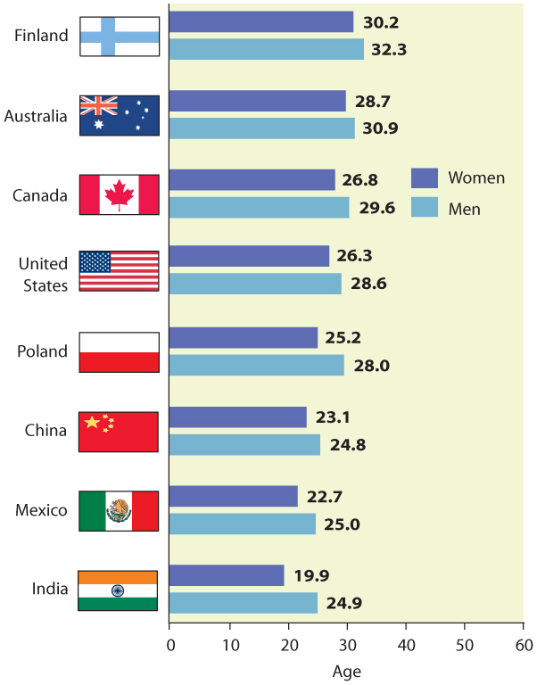
Figure 40-1: Median Age at
First Marriage in Eight Countries
Module 40

Slide 20
Variations in Family Life and Intimate Relationships
Module 40
Social Class Differences
  U.S. upper class emphasizes lineage and maintenance of family position; lower class families likely to have one parent at home, and children typically assume adult responsibilities
Social class differences
less striking today

Slide 21
Variations in Family Life and Intimate Relationships
Module 40
Racial and Ethnic Differences
  Subordinate status of racial and ethnic minorities in U.S. affects family lives
  Black single mothers belong to kin networks
  Native-American families cushion hardships
  Mexican Americans are more familistic
    Machismo: Sense of virility, personal worth, and pride in one’s maleness
    Familism: Pride in extended family

Slide 22
Sociology in the Global Community
Module 40
Family Life, Italian Style: Thirty-Something and living with Mom
  Do you or someone you know live
  at home with parents? If so, do
  you see the situation as
  similar to that of the bamboccioni?
  In the U.S., what other factors
  might contribute to adult children choosing to live with their parents?

Slide 23
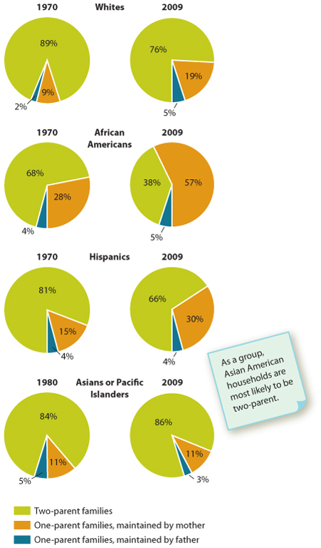
Figure 40-2: Rise of Single-Parent
Families in the United States, 1970-2009
Module 40

Slide 24
Child-Rearing Patterns
Module 40
Parenthood and Grandparenthood
  One of most important roles of
  parents is socialization of children
    Little anticipatory socialization
    Limited learning during pregnancy
    Transition to parenthood is abrupt
Little consensus on how to produce happy, well-adjusted offspring

Slide 25
Child-Rearing Patterns
Module 40
Parenthood and Grandparenthood (continued)
  Recently, U.S. witnessed extension of parenthood with adult children living at home
Sometimes called “boomerang generation” or “full-nest syndrome”

Slide 26
Child-Rearing Patterns
Module 40
Adoption
  Process that “allows for the transfer of the legal rights, responsibilities, and privileges of parenthood” to a new legal parent or parents
Dual-Income Families
  Among married people between 25 and 34, 95% of men and 68% of women in labor force

Slide 27
Child-Rearing Patterns
Module 40
Single-parent families: Only one
parent is present to care for children
  In 2009, single parent headed about 24%
  of White families with children under 18
    34% of Hispanic families with children
    62% of African-American families with children
Households headed by single fathers more than quadrupled from 1987 to 2008

Slide 28
Child-Rearing Patterns
Module 40
Stepfamilies
  Approximately 45% of all people in U.S. will marry, divorce, and remarry
  Nature of blended families has social significance for adults and children
  Cherlin: “Well-being of children in
  stepfamilies is no better, on average,
  than the well-being of children in
  divorced, single-parent households”

Slide 29
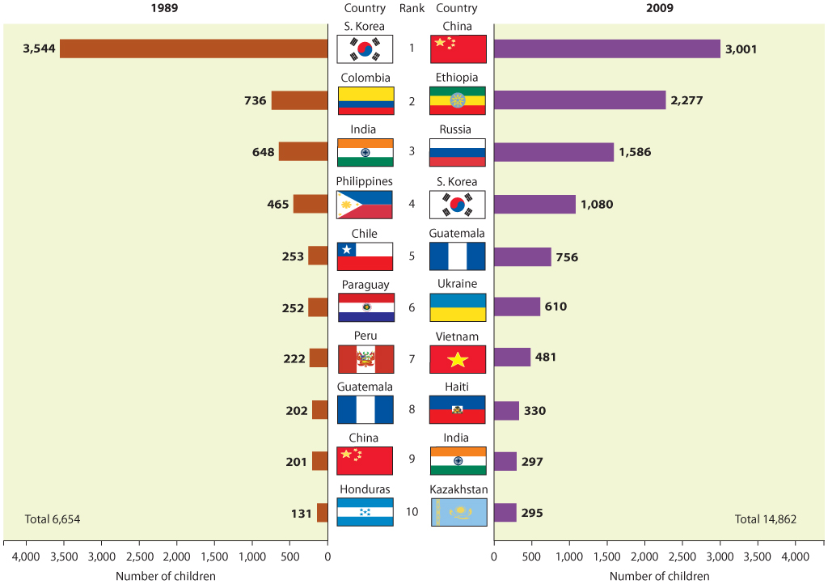
Figure 40-3: Foreign-Born Adoptees by Top 10 Countries of Origin, 1989 and 2009
Module 40

Slide 30
Statistical Trends in Divorce
Module 41
Divorce rates increased in
late 1960s, then leveled off
Since late 1980s, it has declined by 30%
  Partly due to aging baby-boomer
  population and decline in
  proportion of people of marriageable age
About 63% of all
divorcees have remarried

Slide 31

Factors Associated with Divorce
Module 41
Factors in increase in divorce:
  Greater social
  acceptance of divorce
  More liberal divorce laws
  Fewer children
  Greater family income
  More opportunities
  for women

Slide 32
Impact of Divorce on Children
Module 41
National study that tracked 6,332
children before and after divorce
found their behavior did not suffer
Other studies have shown greater unhappiness among children
who live amidst parental conflict
Simplistic to assume children are automatically better off following breakup

Slide 33
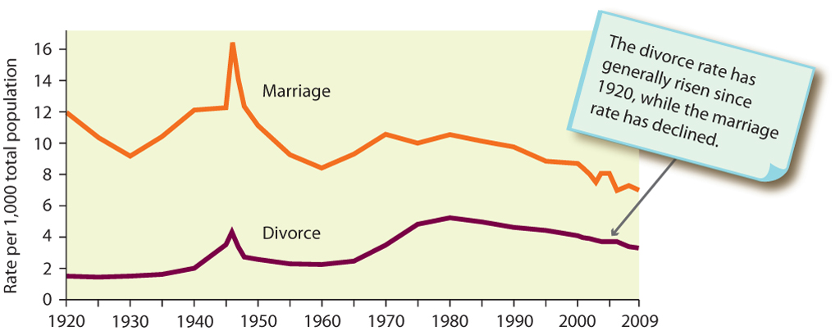
Figure 41-1: Trends in Marriage and
Divorce in the United States, 1920-2009
Module 41

Slide 34
Diverse Lifestyles
Module 41
Marriage has lost much of its social significance as a rite of passage
U.S. marriage rate declined since 1960
  Postponing marriage until later in life
  Forming partnerships without marriage

Slide 35
Diverse Lifestyles
Module 41
Cohabitation: Male-female couples who choose to live together without marrying
  About half of currently married couples in
  U.S. say they lived together before marriage
Remaining Single
Trend toward maintaining single lifestyle
for longer period related to growing
economic independence of young people

Slide 36
Diverse Lifestyles
Module 41
Marriage without Children
  About 16% to 17% of women will
  complete childbearing years without
  children compared with 10% in 1980
Lesbian and Gay Relationships
Gay and lesbian couples face discrimination on both personal and legal levels

Slide 37
Research Today
Module 41
Divorce and Military Deployment
  Do you know any married couples
  who have been separated by military deployment overseas? If so, what
  was the effect on their children?
  Can you think of some other reasons why military marriages might survive
  the strain of war as well as they do?

Slide 38
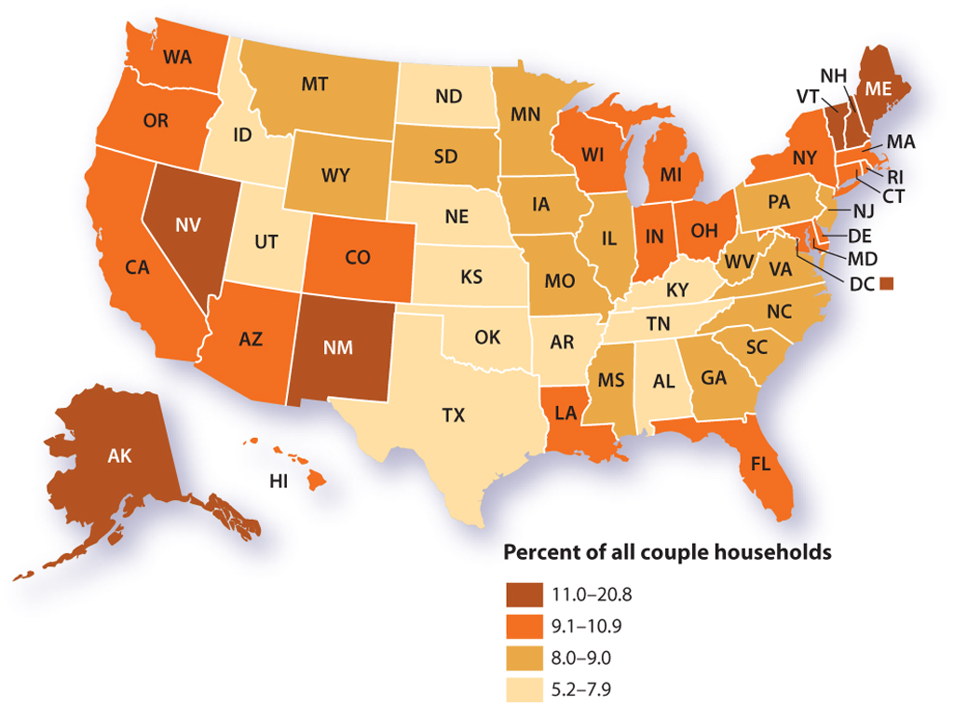
Figure 41-2: Unmarried-Couple Households by State
Module 41

Slide 39
Gay Marriage
Module 41
Understanding the Issue
  Attitudes toward marriage are complex
    Society and culture suggest youth
    should find perfect mate and marry
    Young people also bombarded
    with acceptability of divorce
    Idea of same-sex marriage strikes some
    in U.S. as attack on traditional marriage

Slide 40

Gay Marriage
Module 41
Understanding the Issue
  Vermont gave gay couples legal
  benefits of marriage through civil union
  Massachusetts Supreme Court ruled state’s constitution gives gay couples right to marry

Slide 41
Gay Marriage
Module 41
Applying Sociology
  Functionalists: marriage
  closely tied to reproduction;
  religious views cannot be ignored
  Conflict theorists: denial of right to
  marry reinforces second-class citizenship
  Interactionists: focus on support or
  opposition of family, co-workers, and friends

Slide 42
Gay Marriage
Module 41
Initiating Policy
  Recognition of same-sex
  partnerships not uncommon in Europe
    Trend toward recognition in North America
  Domestic partnership: Two unrelated
  adults sharing a caring relationship,
  residing together, who agree to be jointly responsible for dependents, basic living expenses, and common necessities

Slide 43
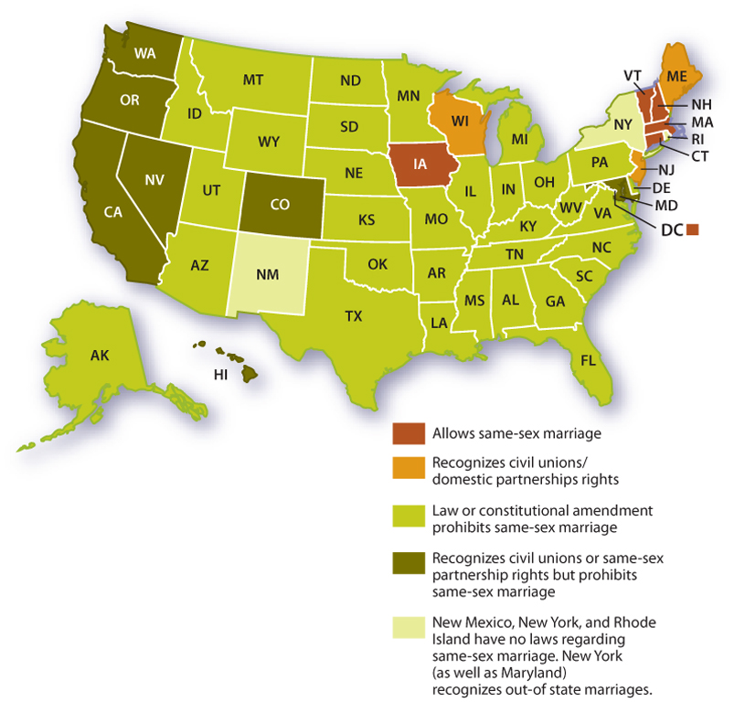
Figure 41-3: Gay Marriage by State
Module 41

